Slide 1

BUSINESS DATA CAPSTONE MANAGEMENT
OPTIMIZING WORKFLOW AND MINIMIZING OPERATIONAL COST FOR SALON BUSINESS
Sanskar Gupta [22f3003170]

Slide 2
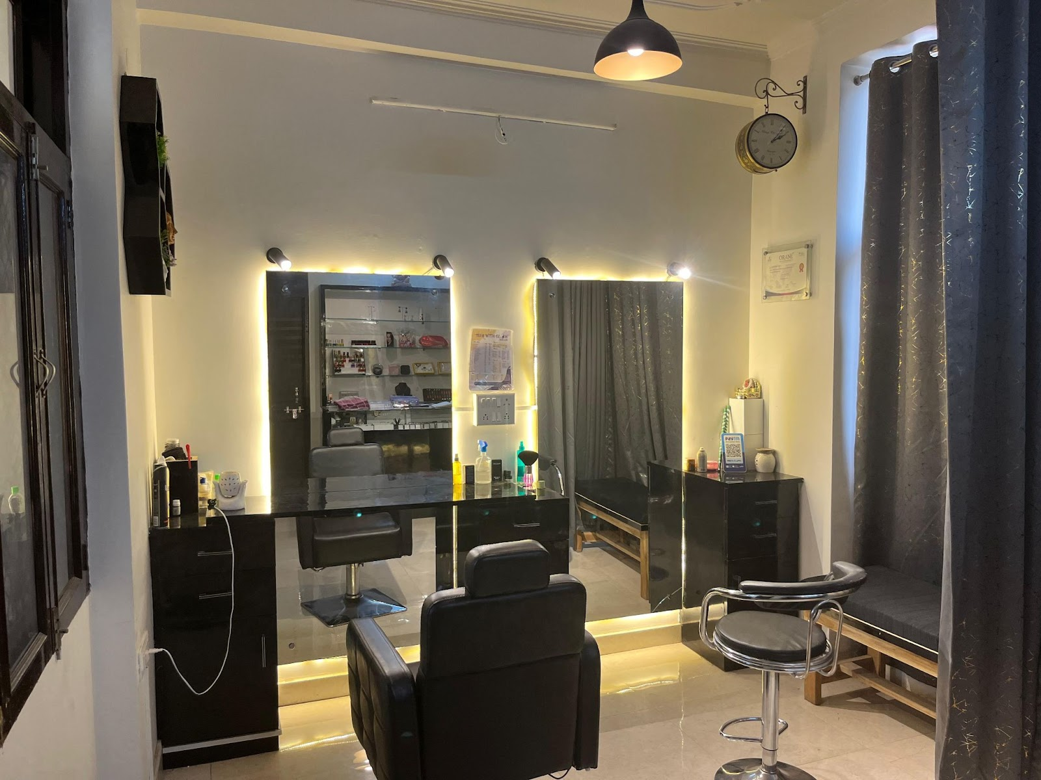
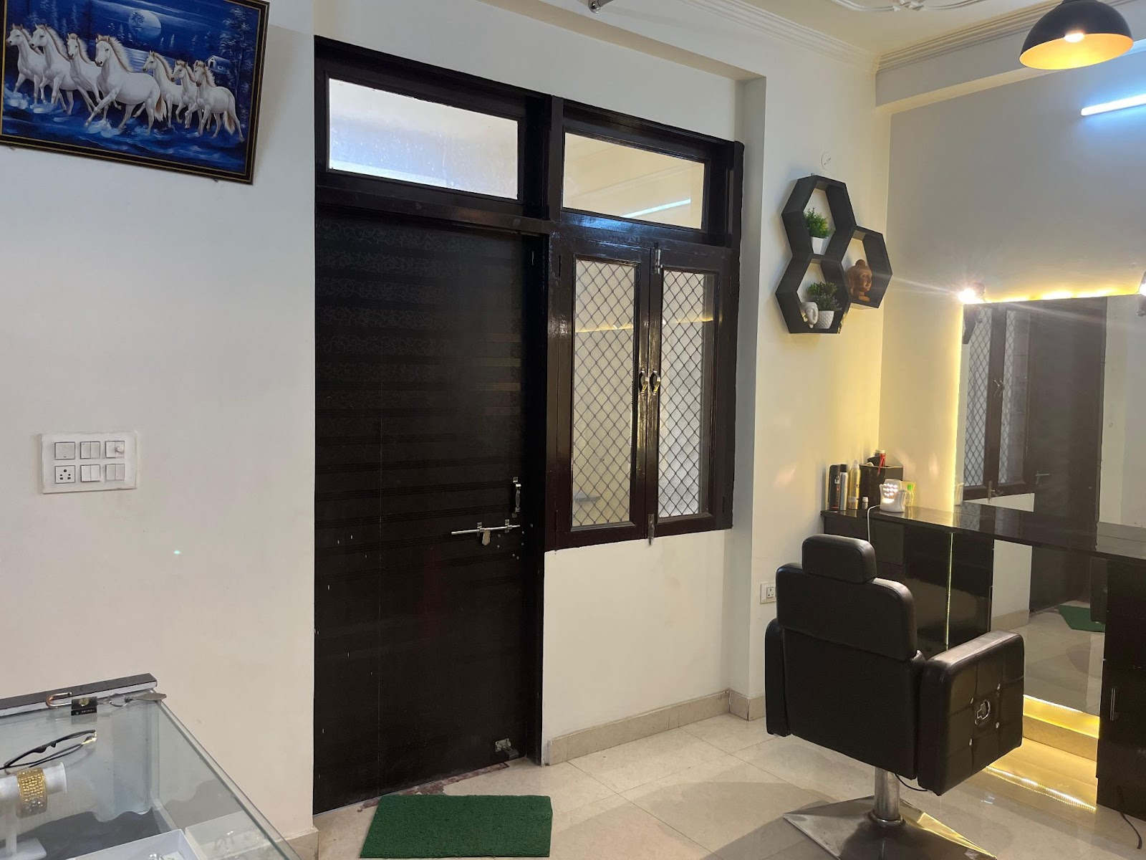
ABOUT THE BUSINESS
3
‘Trim with Glow Salon’ is a small female beauty salon that directly deals with the customer in the segment of salon services. The salon offers more than 100 services in different categories like hair and beauty
The salon is located in Jaipur, Rajasthan and is famous in its locality for great and professional services. The salon aims to expand more and increase its customer base by offering a wide range of beauty and wellness services.

Slide 3
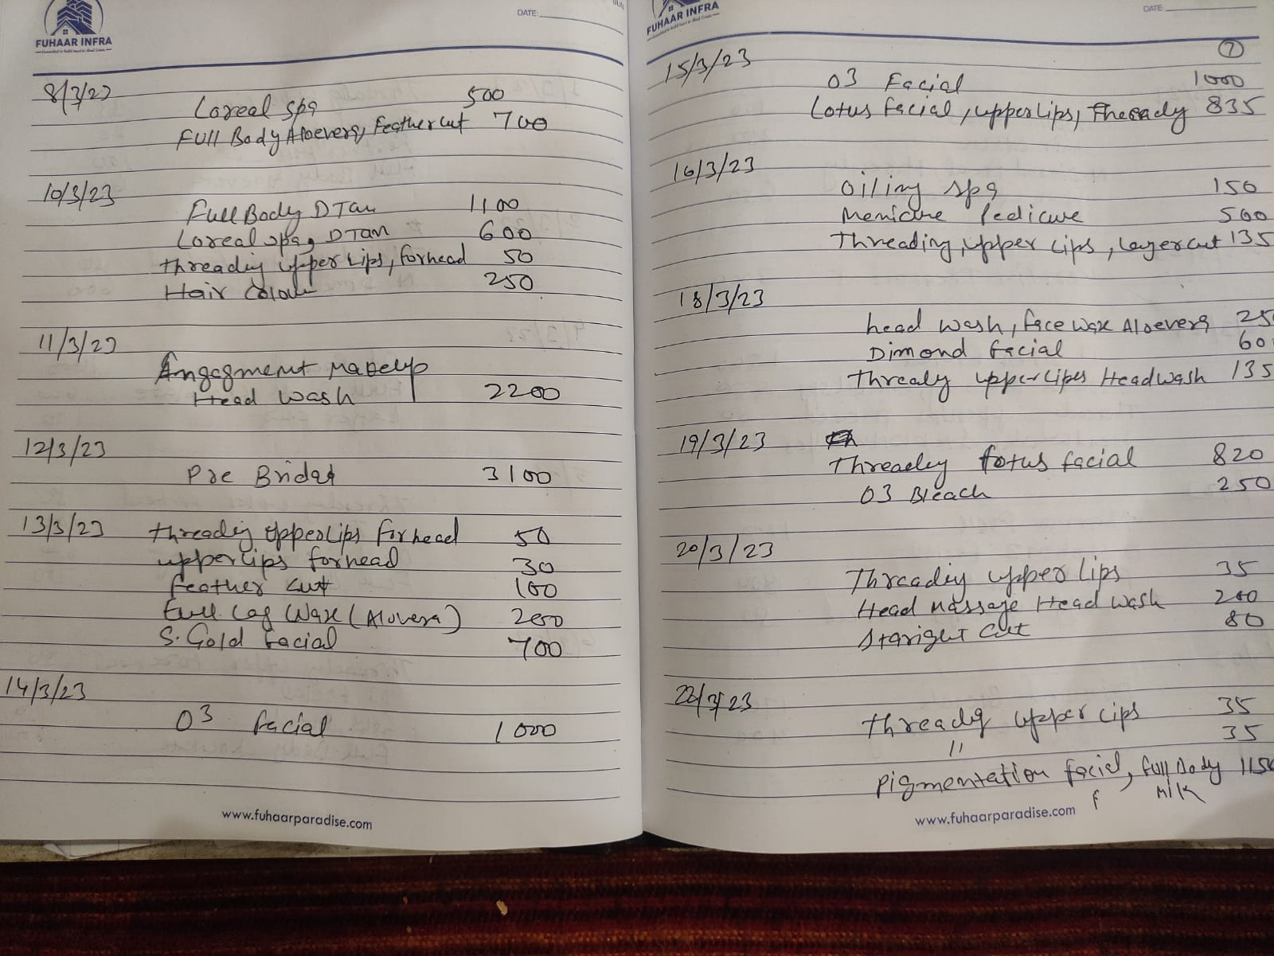
PROBLEMS and DATA
PROBLEMS
DATA
Tracking revenue, expenditure and profits
Daily services data
From Jan 2023 – June 2023
Service List
Fixed Expenditure Data
Water bills
Electricity bills
Maid charges
Refreshment Charges
Include product cost for each service
Divided in Categories
Ideas for salon expansion
Increase profitability
Reduce product wastage

Slide 4
Analysis Overview
1
Business overview
Expenditure
Revenue
Profits
2
In-depth Analysis
Categories performance
Product Costs
3
Category Wise analysis
Individual services performance

Slide 5
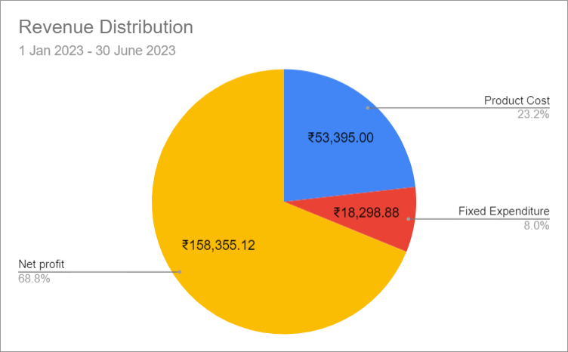
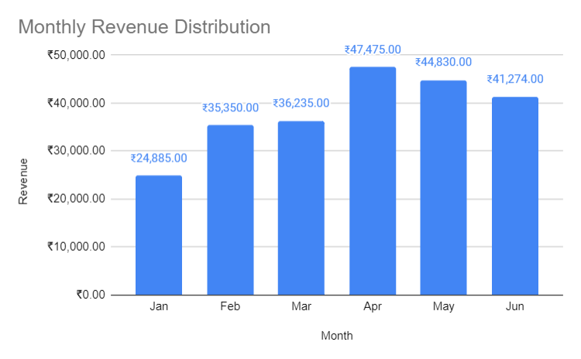
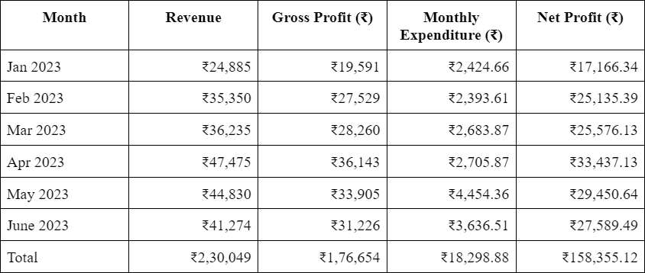
Business Overview
A total of ₹2,30,049 revenue is generated in the span of 6 months (Jan 23 - Jun 23). In this time a total of 617 services were done by salon with approximately 4.08 services per day.
The salon has a net profit of Rs. 158,355, which constitutes 68.8% of its total revenue.

Slide 6
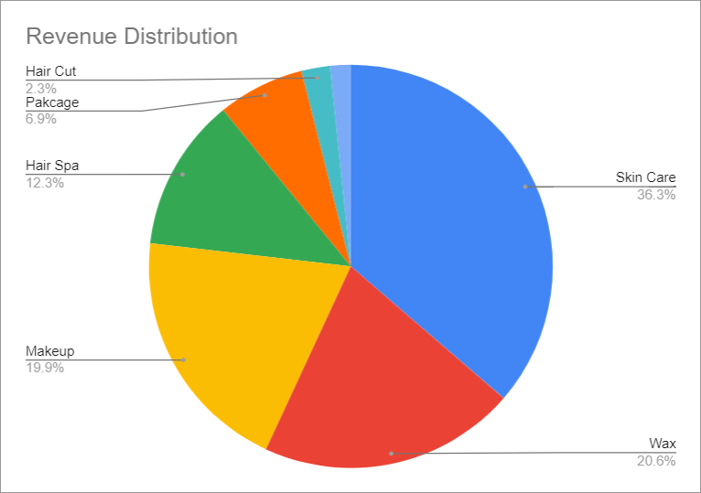
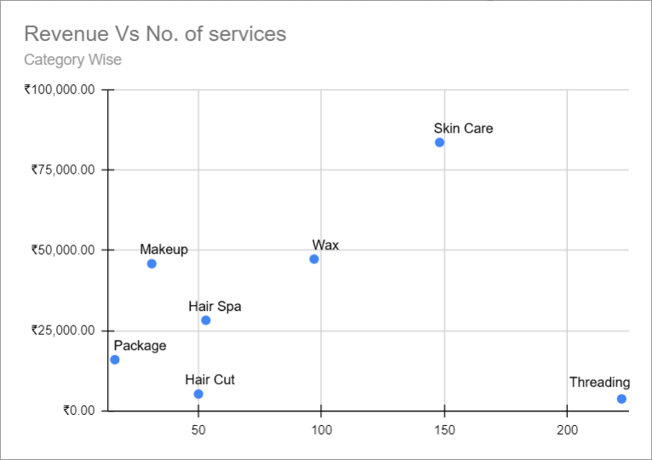
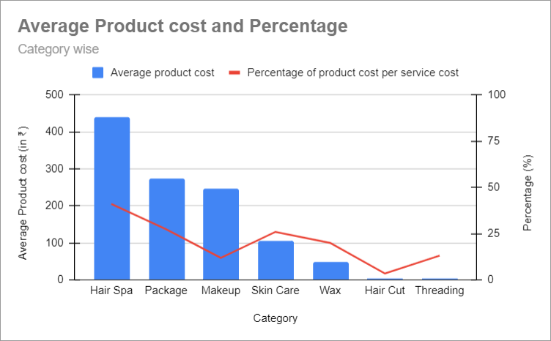
In-depth Analysis
All salon Services are divided into 7 Categories:
Skin Care
Wax
Makeup
Hair Spa
Package
Haircut
Threading

Slide 7

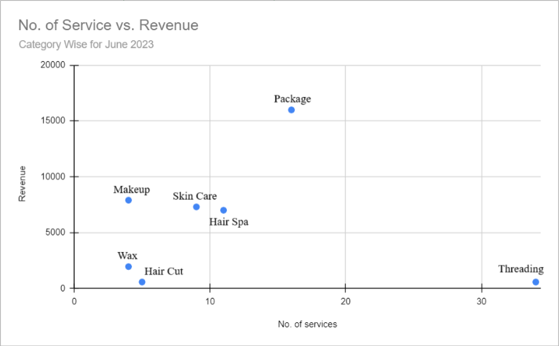
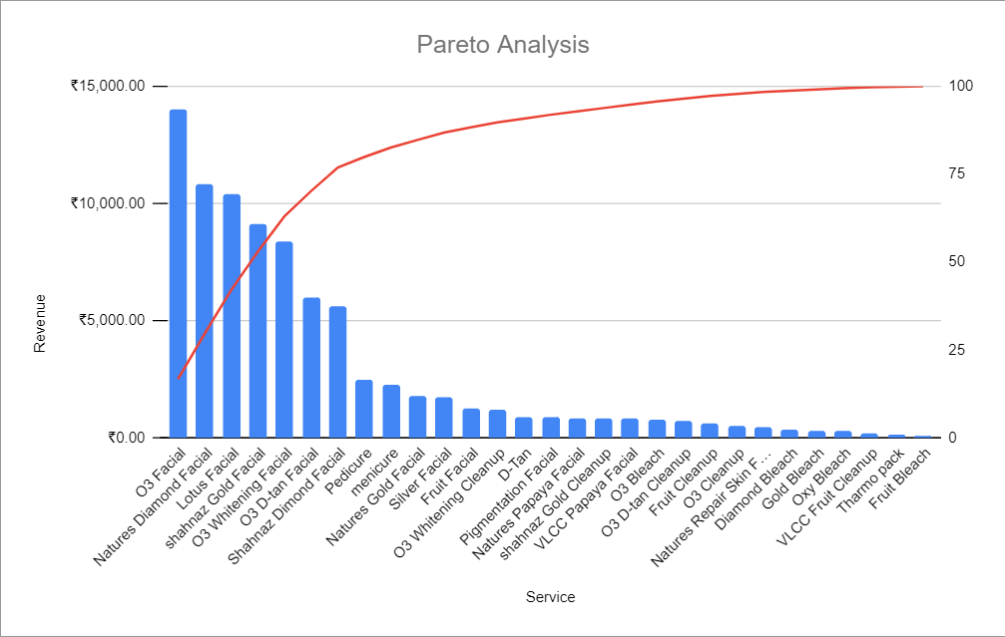
Introduced in June have a single package as of now called “summer offer package”. In this package out of 10 any 6 services can be opt at just ₹999. Those options include:
Oiling Spa
Manicure
Pedicure
Fruit Facial
Fruit cleanup
D-tan
Oxy Bleach
Hair cut
Full Legs Honey
Hand Wax Honey
Total revenue: ₹83,610
Percentage of Total Revenue: 36.34%
Number of services: 148
Average service cost: ₹408.66
Average product cost: ₹105.88
Profit Margin: 74.09%
Total revenue: ₹15,984
Percentage of Total Revenue: 6.9%
Number of services: 16
Average service cost: ₹999
Average product cost: ₹273
Profit Margin: 72.67%

Slide 8
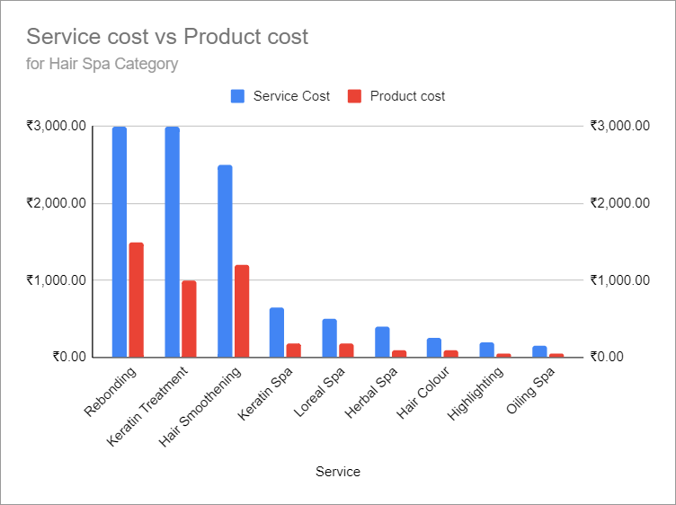
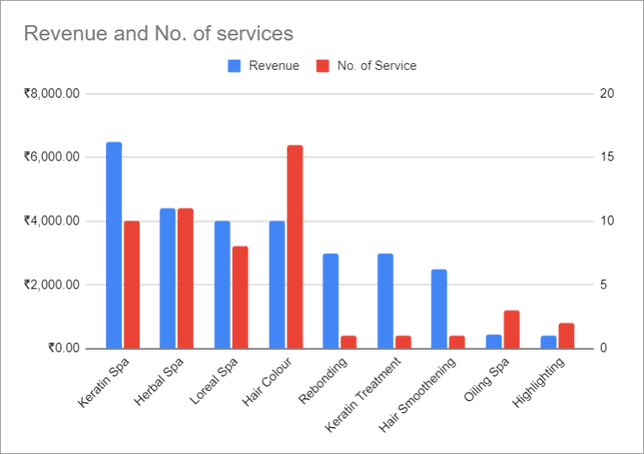
Hair Spa Category
Total revenue: ₹28,250
Percentage of Total Revenue: 12.3%
Number of services: 53
Average service cost: ₹1075
Average product cost: ₹441
Profit Margin: 58.98%
Product cost for the services in this category can be as high as 50%-40% like in Rebonding, Keratin treatment and Hair smoothening. Offered only 1 time in 6 months not only decreases profit margins but also creates wastage.
With a profit margin of 72.3%, keratin Spa generated revenue of ₹6,500 in 10 services.

Slide 9
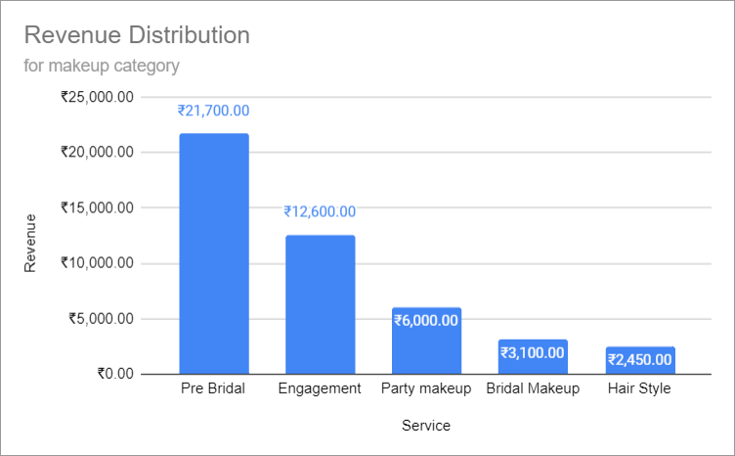
Other Categories
Makeup Category
Total revenue: ₹45,850
Percentage of Total Revenue: 19.9%
Number of services: 31
Average service cost: ₹2083.33
Average product cost: ₹246.67
Profit Margin: 88.16%
Haircut Category
Total revenue: ₹5,290
Percentage of Total Revenue: 2.3%
Number of services: 50
Average service cost: ₹113.08
Average product cost: ₹3.84
Profit Margin: 96.6%
Wax Category
Total revenue: ₹47,290
Percentage of Total Revenue: 20.6%
Number of services: 97
Average service cost: ₹241.67
Average product cost: ₹48.27
Profit Margin: 80.03%
Threading Category
Total revenue: ₹3,775
Percentage of Total Revenue: 1.6%
Number of services: 222
Average service cost: ₹26
Average product cost: ₹3.4
Profit Margin: 86.92%

Slide 10
Suggestions and Recommendations
Marketing and Advertising: Develop targeted marketing campaigns to raise awareness of key services, promotions, and packages to attract new customers and retain existing ones.
Pricing Strategy: Consider a slight price increase for high footfall services to improve profit margins without significantly impacting demand like Threading.
Package Innovation: Introduce new and attractive packages to capitalize on the popularity of package offerings. Experiment with different combinations of services to appeal to customer preferences and enhance revenue. Experimenting with different packages can boost opportunities for mid-performing services by attracting customers with unique offers.
Revamp Underperforming Services: Evaluate and potentially eliminate or revamp underperforming services that contribute minimally to revenue and footfall to optimize resource allocation.
​

